Slide 1


SAP S/4HANA CDS, RAP Training Day 6
Anubhav Oberoy

Slide 2

Agenda – Day 6
Challenges in ABAP Development
Evolution to the ABAP programming language
RAP – Restful Application Programming
Definition of Business Object
Types of Implementation
--break
BO Runtime lifecycle
Flight data model
Flow of development
--break
Create Interface CDS views
Create Service definition
Service implementation
Introduction to Fiori Elements
Create First display app using VS Code
Adding metadata extension
Notes:
https://unsplash.com/photos/CPs2X8JYmS8

Slide 3





Challenges in ABAP development
UI
Common needs
Create application logic
Insert, update, delete, validate, select data
Perform validations
Check customizing
Handle locks
Create A/c documents
Manage Documents
Application Code
I, U, D, S, V
Search Documents
Validate before save
Alex, ABAP Developer,
SAP FICO
UI
Challenges
Thinks differently
Adapt application code
High maintenance
No standardization
Different coding practices
Lack of standard
Create Sales Orders
Manage Sales Orders
Application Code
I, U, D, S, V
Search/Filter Sales Order
Compute Sales total
Stella, ABAP Developer,
SAP SD
Trainer: Anubhav Oberoy

Slide 4
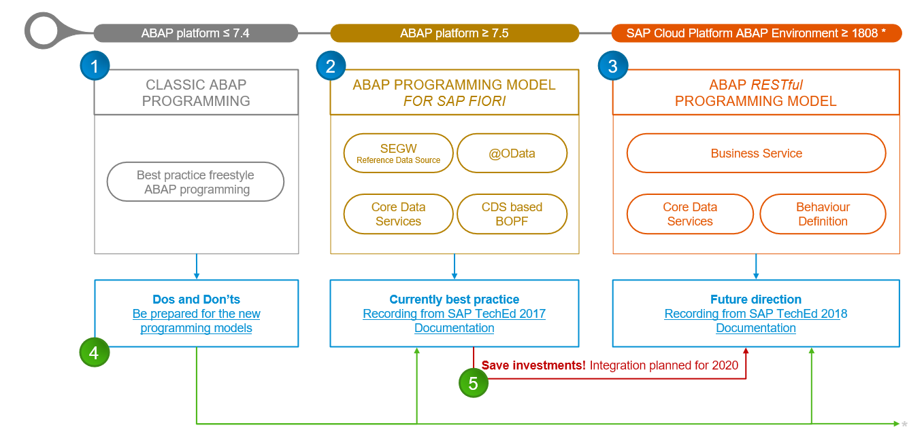
Evolution of ABAP Programming Model

Slide 5
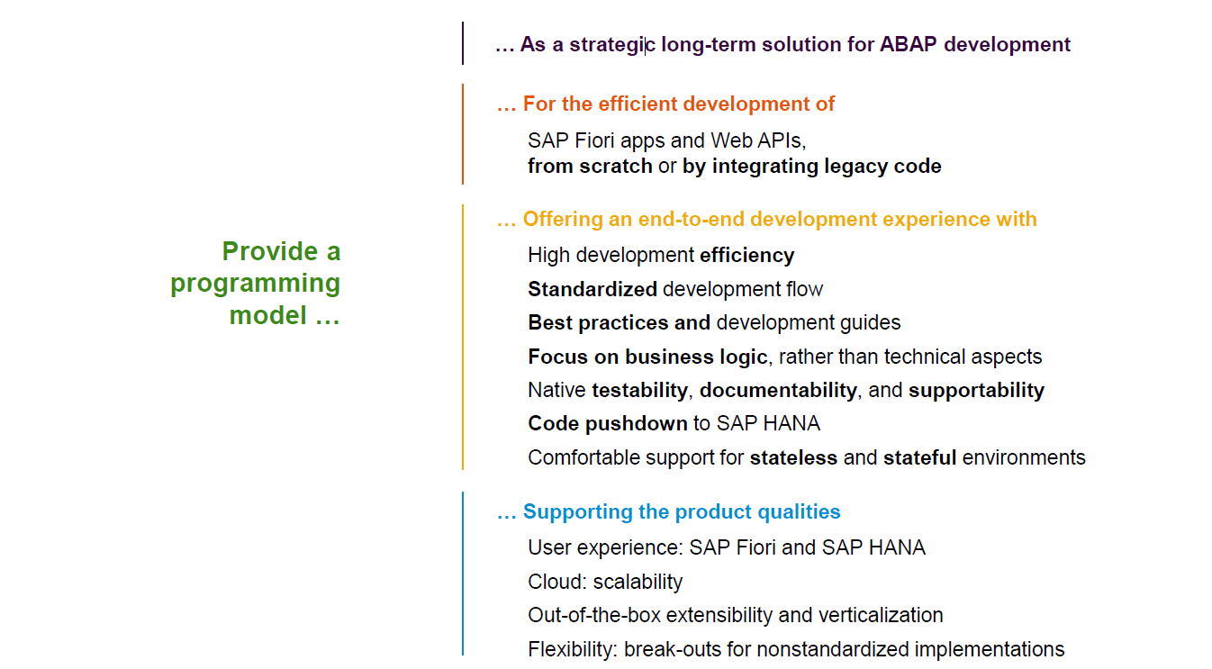
Restful ABAP Programming

Slide 6
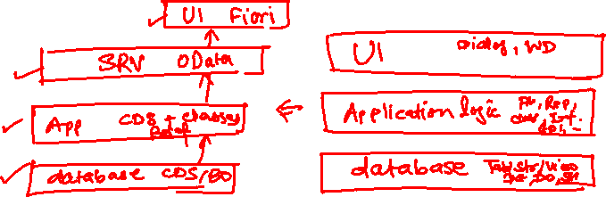
Restful ABAP Programming
The ABAP RESTful programming model defines the architecture for efficient end-to-end development of intrinsically SAP HANA-optimized OData services (such as Fiori apps) in SAP Business Technology Platform ABAP Environment. It supports the development of all types of Fiori applications as well as A2X services. It is based on technologies and frameworks such as Core Data Services (CDS) for defining semantically rich data models and a service model infrastructure for creating OData services with bindings to an OData protocol and ABAP-based application services for custom logic and SAPUI5-based user interfaces .
The whole architecture is based on
CDS views – will helps you to create semantically rich data model.
Business Object here is a node inside a tree data structure which is achieved by using root keyword at CDS view level, this is needed only if we want to add transactional capability.
Finally create a service using service definition and service binding .
The binding will confirm the Purpose of service – API or Fiori.
UI layer with the Fiori app using elements.

Slide 7

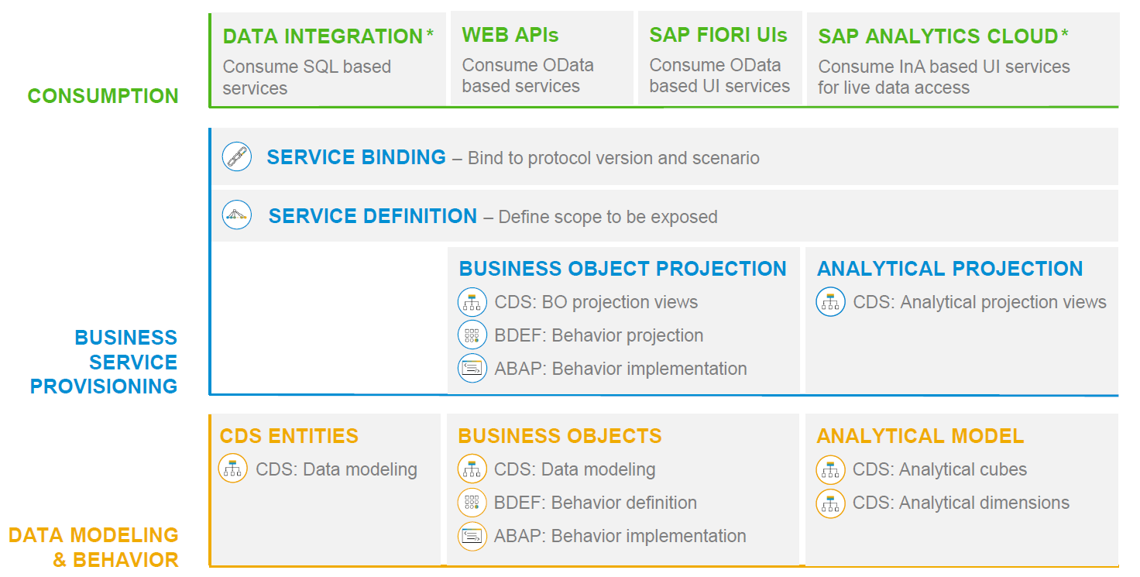
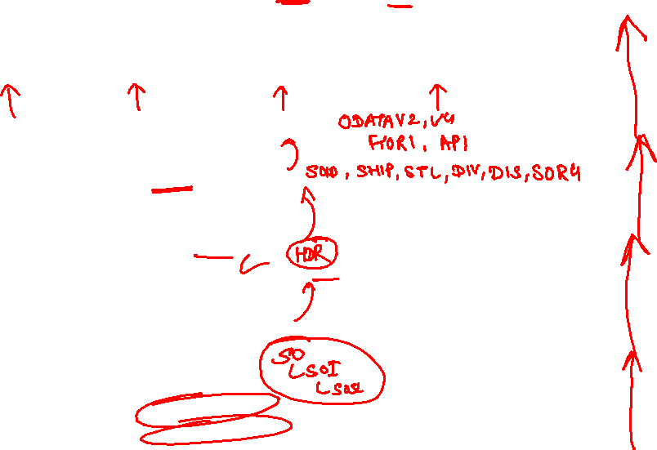
RAP – The Big picture

Slide 8
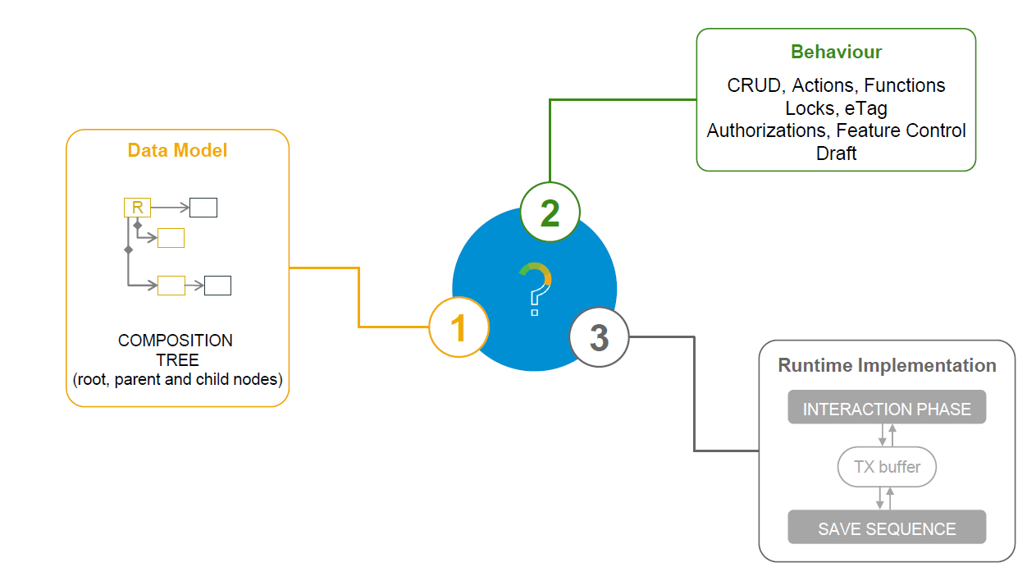
What is a Business Object

Slide 9
Types of Implementation (Scenario)
Brownfield Implementation
Is used when we want to create a transactional application which can insert, update, delete data from the system by writing your own logic
You already have Business logic with you and you want to use that business logic to perform transactional capability
You are own your own to manage your implementation.
02. Managed Scenario
Greenfield Implementation
Is used when we want to create a transactional application which can insert, update, delete data from the system by using the framework provided implementation
You do not have Business logic with you and you want system to create business logic for you automatically.
01. Un-Managed Scenario

Slide 10
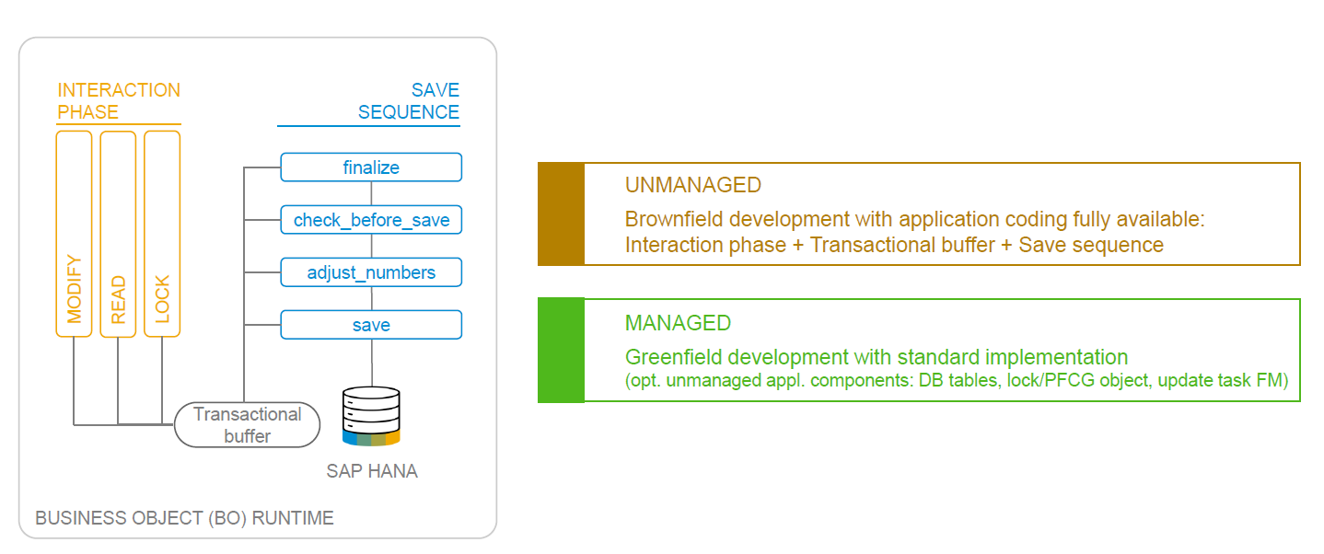
BO runtime implementation types

Slide 11
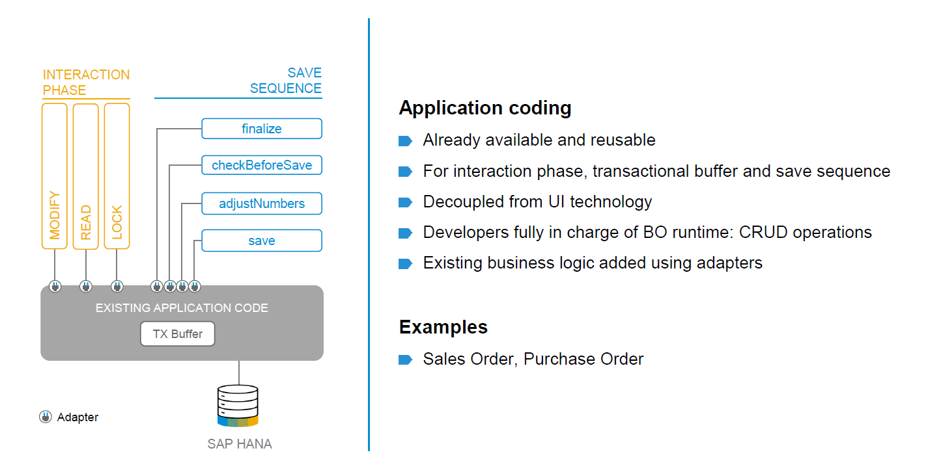
BO runtime implementation types

Slide 12













































Slide 13

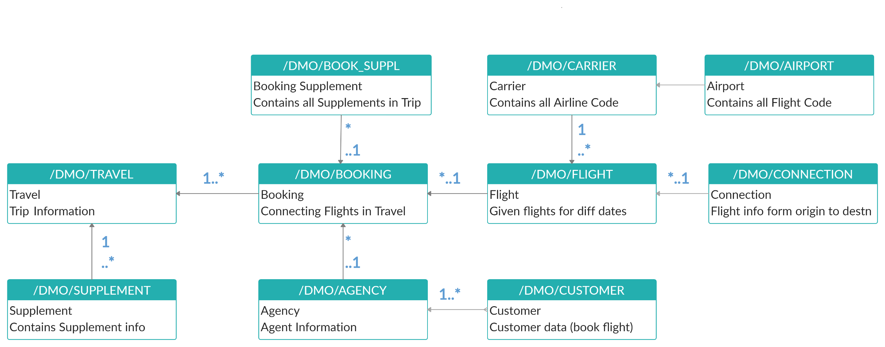
Explanation of Flight Data Model
If Data is not found in these Table’s please execute Data Generator Class “/dmo/cl_flight_data_generator”

Slide 14
Flow of Development (Unmanaged Scenario)
Fiori UI
Service Binding for UI
Service Definition
Travel – Using /demo/travel
Projection view- what we want to show to UI
1
N
I_Currency
1
N
N
Agency
Customers
I_Country

Slide 15
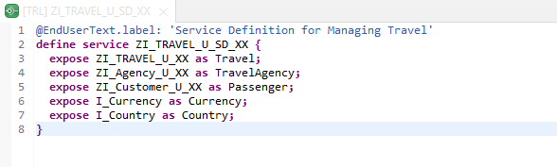
Create OData Service ( Business Service )
Create OData Service ( Business Service )
A business service definition (short form: service definition) describes which CDS entities of a data model are to be exposed so that a specific business service, for example, Sales Order handling, can be enabled. It is an ABAP Repository object that describes the consumer-specific but protocol-agnostic perspective on a data model.
CDS Entity
Service Definition
Service Binding

Slide 16
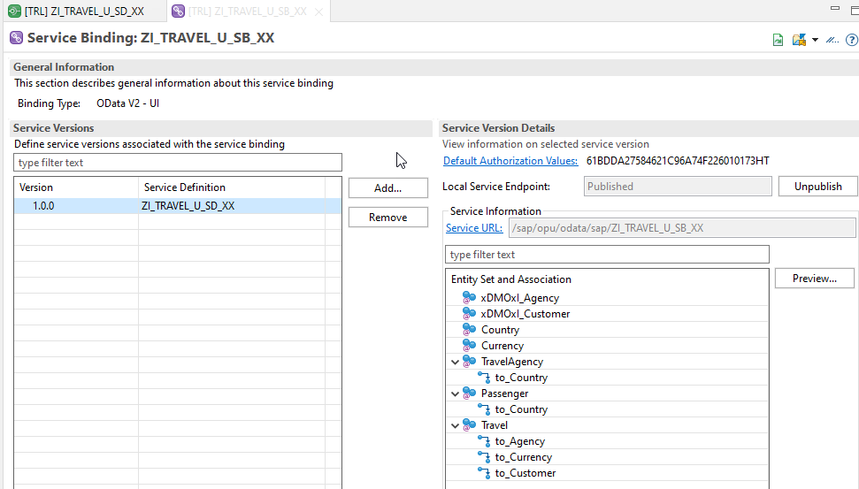
Service Binding ( Business Service )
Service Binding ( Business Service )
The business service binding (short form: service binding) is an ABAP Repository object used to bind a service definition to a client-server communication protocol such as OData. Like any other repository object, the service binding uses the proven infrastructure of the ABAP Workbench, including the transport functionality

Slide 17

Introduction to SAP Fiori Elements
SAP Fiori elements provides standard floorplans and uses metadata to streamline and accelerate developing SAPUI5 applications.
SAP Fiori elements
▪ Delivers enterprise-ready SAPUI5 apps based on
stable, optimized, out-of-the-box UI code
▪ Boosts developer efficiency by scaling development
and maintenance in a cost-efficient way
▪ Provides a centrally managed, consistent UX
complying with the latest SAP Fiori design
▪ Ensures upgrade stability and forward compatibility
▪ Allows extensibility of standard floorplans with custom
controls and logic
www.anubhavtrainings.com

Slide 18
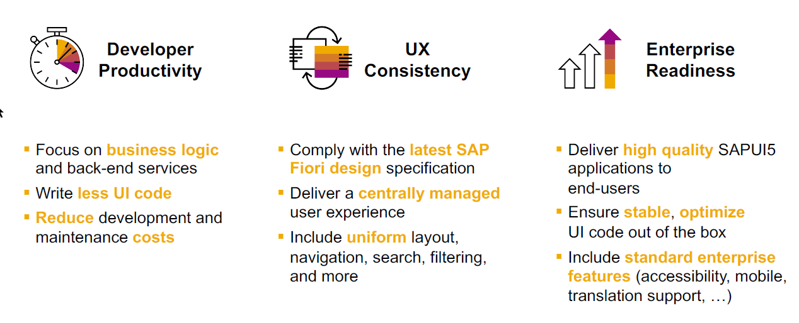
SAP Fiori elements boosts SAP Fiori development efficiency
www.anubhavtrainings.com

Slide 19
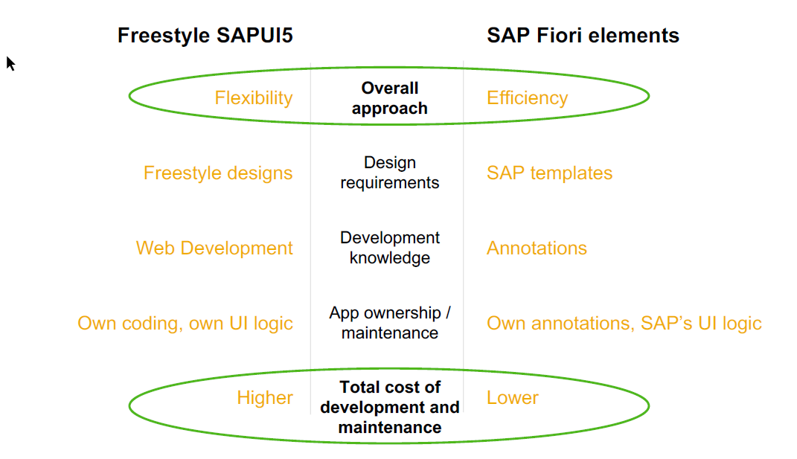
SAP Fiori elements prioritizes efficiency over flexibility
www.anubhavtrainings.com

Slide 20


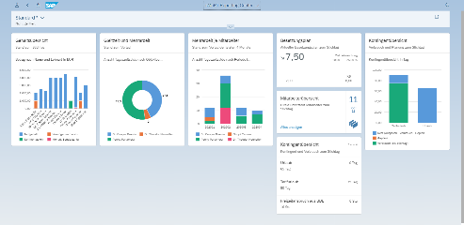





Developer Persona – Fiori Elements
Anubhav
Happy User
Rob
S/4HANA Technical consultant
ABAP Developer
Roxana
UX Designer | Fiori Developer
ABAP Dev. Tools
On
Eclipse
VS Code
BAS
OData Service
Fiori Elements Project
Annotations.xml
CDS Views
MDE
@
www.anubhavtrainings.com

Slide 21
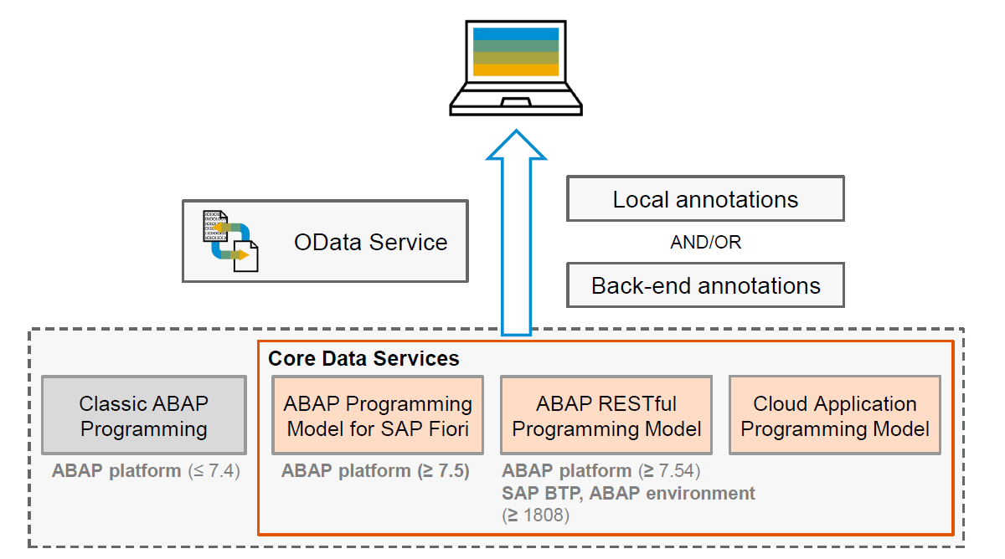
Big Picture – Architecture
www.anubhavtrainings.com

Slide 22
Fiori Elements - List Report Application
The list report offers powerful features for finding and acting on relevant data sets. It is often used as an entry point for navigating to the item details, which are usually shown on an object page.
List Report
Object Page
www.anubhavtrainings.com

Slide 23
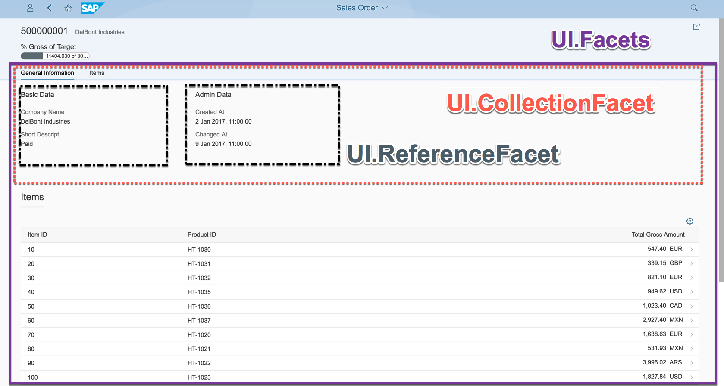
Object Page
www.anubhavtrainings.com

Slide 24
Developing Read only List Report
UI Annotations
@UI.selectionField – Bring a filter field on smart filter bar
@UI.lineItem – enable us to put a column inside the smart table, position, label
@UI.identification – used create fields in Object page
@Semantics.amount.currencyCode – mark the unit of amount field
@UI.headerInfo.typeName – Label for displaying single record
@UI.headerInfo.typeNamePlural – Table Label
@UI.facet: [{purpose : #STANDARD – This will create a section inside the object page
type: #IDENTIFICTION_REFERENCE – What type of data you want to display}]
Metadata Extension
MDE file for Travel
Documentation
Documentation Link for ABAP RAP

Slide 25
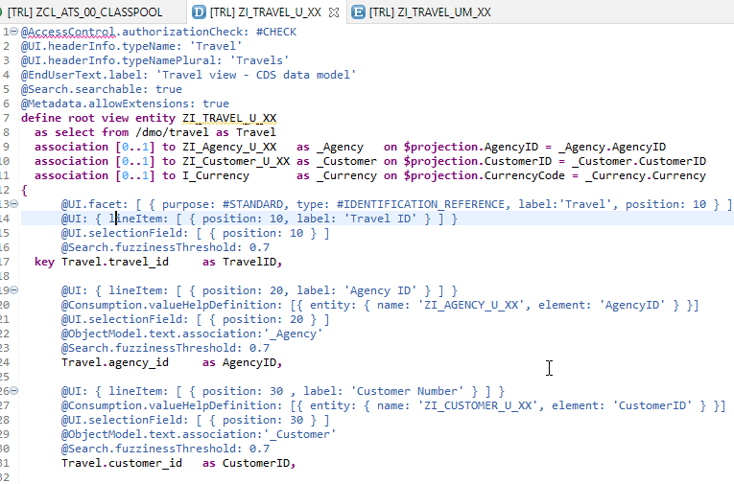
CDS Views with Annotations

Slide 26
Title
Text

Slide 27
Title
Text

Slide 28

Questions?

Slide 29

Thank you
Anubhav.abap@gmail.com
contact@anubhavtrainings.com
+91 84484 54549
www.anubhavtrainings.com

